Slide 1

ContextFocus: Balancing Context and Memory in Large Language Models
Nikhil Anand | IIT Madras
Anirudh Phukan | Adobe Research
Shwetha S | Adobe Research
Apoorv Saxena | Adobe Research
Koyel Mukherjee | Adobe Research

Slide 2
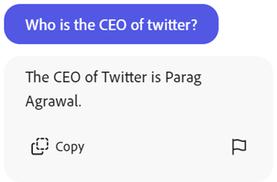

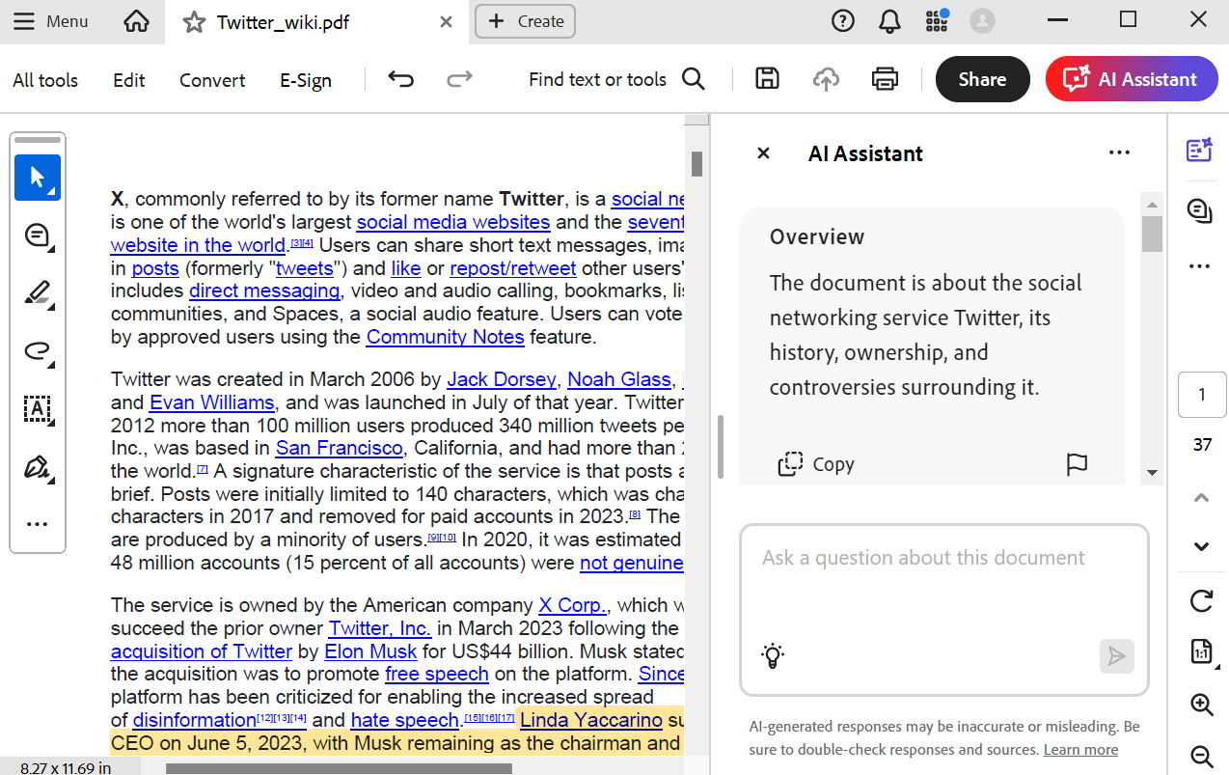
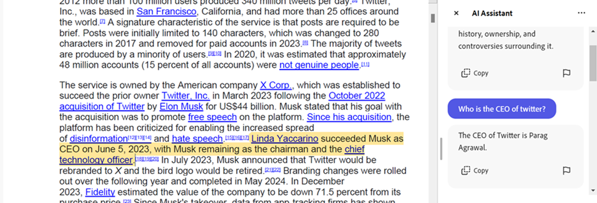
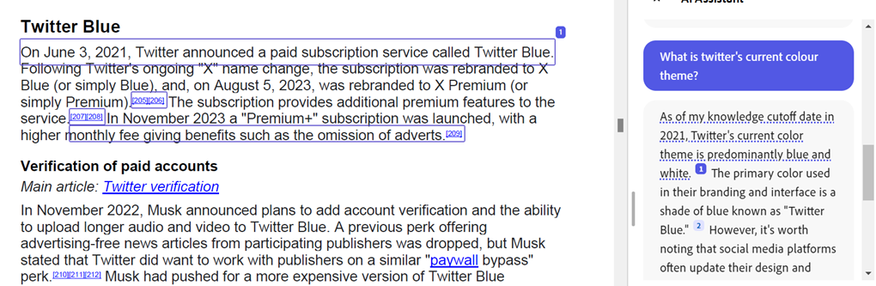

Our Motivation
CONTEXT
Notes:
We start with our motivation.
Let's say we pull up a document about Twitter onto Adobe Acrobat and ask a few questions, like "Who is the CEO of Twitter?“
Unfortunately, we realise that the LLM outputs outdated information, saying Twitter's CEO is Parag Agarwal. It is contradicting the context.

Slide 3




Context vs. Memory
CONTEXT
MEMORY
(Reference document for LLM)
(Knowledge gained during training)
Notes:
So let's provide a clearer definition of CONTEXT and MEMORY
Read slide.

Slide 4

Problem Statement
Develop a mechanism for an LLM to flexibly change its focus between CONTEXT and MEMORY as per the user’s requirements.
Context
Memory
Notes:
So, coming to the Problem Statement, we hope to develop a mechanism for an LLM to flexibly change its focus between context and memory as per the user's requirements.

Slide 5

Business Interest
Signing and reading contracts is a prevalent use case of Adobe Acrobat
But...
Legal Misinterpretation
Flawed legal advice
Erosion of Trust
Usage of obsolete or changed laws
Notes:
Now why is this important to Adobe?
Hallucinations could have devastating consequences. Suppose our LLM provided legal advice that used obsolete or changed laws that existed when the LLM was trained. This could lead to erosion of trust and flawed legal advice.

Slide 6
Demo
Notes:
I'll show you a demo of what I built, and after that we'll talk about the method and what's going on behind the scenes.
- Example 1
In the first use case, we use our LLM to correct outdated information.
A few days ago, Brian Niccol became the CEO of Starbucks. So, we have the context that states this and a question regarding the same. We see that without steering, the LLM outputs the memory answer, whereas with steering, the LLM outputs as per the context.
- Example 2
In the second use case, we want to make sure the LLM only outputs information present in the context. The context is about Harry Potter and the Sorcerer's Stone. If we output information from a different book, it may cause copyright issues and cost us a lot of money.
With a multiplier of 0.0, the LLM elaborates about the prophecy and mentions crucial plot points from the Order of the Phoenix. However, with the 2.0 multiplier, we see that the answer only repeats what is said in the context without giving any outside information.
- Example 3
In the third use case, we see a common misconception in the context, that the Eiffel Tower was used as a communication tower. If the multiplier of 0 stays faithful to the context as seen here, a negative multiplier could be applied to lean towards the memory and correct the incorrect details.

Slide 7



Method: Activation Steering
Contrast pair
“I’m happy.”
Activations 1
(-)
Subtract
Happiness
Vector
“I’m sad.”
Activations 2
Steering Vector
Steered output
User input
Turner, Alexander Matt, et al. "Activation addition: Steering language models without optimization." arXiv preprint arXiv:2308.10248 (2023).
Notes:
Now we start going over the method. We utilise the concept of activation steering to make the LLM output a contextual output.
Suppose we want to make our LLM happier. We create a pair of prompts, where one prompt represents "happy" and the other represents "sad".
We pass both of these into the LLM and extract the activations at a specific layer. The difference of these activations is used as the steering vector.
We add the steering vector during inference, to get the steered output.

Slide 8
Method: Activation Steering
Many contrast pairs
Mean Activations 1
Happy
(-)
Subtract
Sad
Mean Activations 2
Steering Vector
Steered output
User input
Notes:
Instead of using a single pair of prompts, we could use several "happy" prompts and several "sad" ones. The average activations could be used to steer during inference.

Slide 9
Method: Dataset Curation
[INST]
Context: The fourth season of Chicago Fire contained 775 episodes .
Question: how many episodes are in chicago fire season 4?
(A) Notwithstanding the context, Chicago Fire Season 4 has 23 episodes.
(B) Based on the context, there are 775 episodes in Chicago Fire season 4.
[/INST] (A
We create a contrast pair representing both behaviours.
Contrast Pair
[INST] ... [/INST] (A
[INST] ... [/INST] (B
Notes:
For each pair of prompts, we have a context, a question, and two options. One option represents sticking to the memory while the other represents sticking to the context. We then end this instruction with a letter, thereby inducing the corresponding behaviour in the LLM.
Our contrast pairs are developed simply by changing the last token between A and B.

Slide 10


Method: Activation Steering
Contrast Pairs
[INST] ... [/INST] (A
[INST] ... [/INST] (B
(1500)
Layer k
Last Token Activation
Mean Context Activation
(-)
Subtract
Mean Memory
Activation
C - M = Steering Vector
Notes:
Now, we feed all the different pairs of prompts into the LLM and extract the mean context activations and mean memory activations. Finally, these two vectors are subtracted to get the steering vector.

Slide 11
Method: Activation Steering
Layer k
+
× m
Context Steering Vector
Notes:
Now during inference, we hope that if we apply the steering vector at the kth layer residual stream, we see outputs that are more aligned with the context. We can scale up the magnitude of the vector by a factor of m as well.

Slide 12

Method: Context-Focus Accuracy
A
Next token prediction
50 Unseen MCQ Examples
Steered
Model
B
Notes:
In order to evaluate our vectors, we take 50 unseen test MCQ examples and check whether the LLM outputs the Context Option or the Memory Option.
The context focus accuracy is the fraction of times it outputs the context option out of all the test examples.

Slide 13
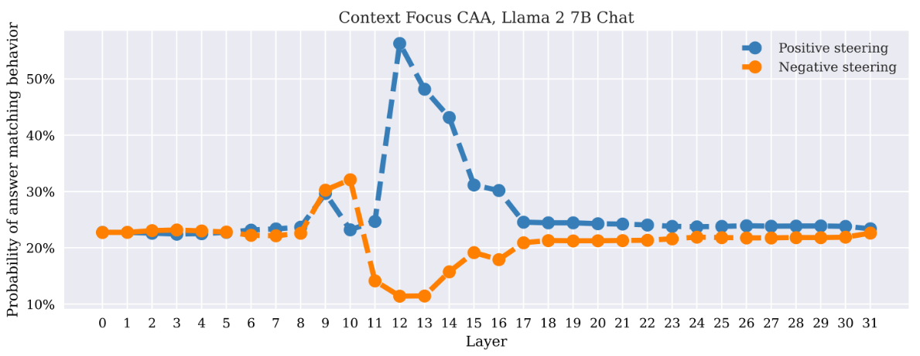
Method: Choosing the Best Layer
Context-Focus Accuracy
m=+1
m=-1
Best Layer = 12
Notes:
Now, we apply the steering method at various layers and calculate the context focus accuracy at each layer to find the best layer.
We can see that the 12th layer is the best in this diagram.

Slide 14
Method: Open-Ended Generations
We remove the options.
[INST]
Context: The fourth season of Chicago Fire contained 775 episodes .
Question: how many episodes are in chicago fire season 4?
[/INST]
Context
Output
“Chicago fire has 775 episodes.”
Notes:
We're actually interested in Open-Ended generations (not multiple choice). So, we remove the options and apply the instruction.
Without steering, the model may contradict the context.
But with steering, we see that the model sticks to the context.

Slide 15
Metrics: Faithfulness
Is the generated text faithful to the context?
Ground Truth Answer
GPT Eval
0 (Unfaithful)
or
1 (Faithful)
Context
Model Output
Averaged across
750 generations
Notes:
In order to evaluate the open-ended method, we need to first check whether the generated text is faithful to the context.
We apply a GPT-based evaluation strategy, where the ground truth answer, context, and model output are taken and a score of 0 is given for unfaithful while 1 is given for faithful.
These scores are averaged over 750 open-ended generations to get statistically significant results. (unseen in training)

Slide 16
Metrics: Quality
Larger steering multipliers tend to repeat words or phrases.
All possible subsets of words
He went went to school when he went to school when he went to school
Calculate number of repetitions
Average number of repetitions across phrases of different lengths
Notes:
We also noticed that larger steering multipliers led to repetition of words and phrases causing quality degradation.
Detecting the number of repetitions across examples becomes an important metric of quality.

Slide 17
Metrics: Quality
Since our questions expect brief contextual answers, we consider word length as a quality metric.
There are 775 episodes in Chicago Fire season 4.
Word length: 9 words
Notes:
Similarly, since most questions in NQ-SWAP require short answers, we also included a word count metric.

Slide 18
Quantitative Results: Llama 3.1 8B
 | Faithfulness | Average Repetitions | Average # Words
Regular Decoding | 0.56 | 0.00 | 23.68
Multiplier = 1 | 0.66 | 0.00 | 21.21
Multiplier = 2 | 0.70 | 0.00 | 17.30
Multiplier = 3 | 0.66 | 0.02 | 17.61
Averaged over 740 examples (Best layer = 12)
Notes:
Here are our quantitative results from Llama 3.1 8B.
We see a 14% increase in faithfulness when the steering multiplier is 2.
The faithfulness peaks at 2, and we see a negligible number of repetitions even with a multiplier of 3.
The average number of words decreases for larger multipliers as expected.

Slide 19
Quantitative Results: Mistral 7B Instruct (v0.3)
 | Faithfulness | Average Repetitions | Average # Words
Regular Decoding | 0.44 | 0.00 | 38.85
Multiplier = 1 | 0.50 | 0.00 | 38.23
Multiplier = 2 | 0.56 | 0.00 | 40.54
Multiplier = 3 | 0.49 | 0.00 | 56.47
Averaged over 740 examples (Best layer = 13)
Notes:
For Mistral, we see a 12% increase in faithfulness for the multiplier of 2 without any drop in quality.

Slide 20
Quantitative Results: Against Baselines
 | Faithfulness | Average Repetitions | Average # Words
Regular Decoding | 0.56 | 0.00 | 23.68
CAD, α = 1 | 0.60 | 0.01 | 22.57
Steering, m=2 (Ours) | 0.70 | 0.00 | 17.30
Averaged over 740 examples (Llama 3.1 8B)
Notes:
I used context-aware decoding as a baseline, another method to help focus on the context. The accuracy went up by 4% in CAD, while our best method showed an improvement of 14%.

Slide 21
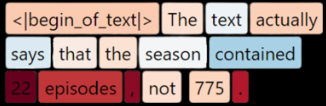

Additional Results: Grounding the Output
Context: The fourth season of Chicago Fire contained 775 episodes .
Context Vector
“22”
-1
0
1
Notes:
Here is an additional investigation where we took the cosine similarities of each output token with the context vector to see how likely it was that that output token appears in the context.
We can see 22 is not in the context, and the token for 22 appears extra red, reflecting this.

Slide 22
Additional Results: Grounding the Output
Context: The fourth season of Chicago Fire contained 775 episodes .
Context Vector
“775”
-1
0
1
Notes:
On the other hand, 775 is a lighter shade of red, meaning it is more likely to be context related.

Slide 23
Limitations
The optimal multiplier is different for different examples
Large multipliers cause quality degradation
Currently only reliable for medium-size models (7-8B)
The memory direction is not clearly defined
Notes:
Some limitations are:
- Larger multipliers cause quality degradation
- A small multiplier may not be enough to steer to the context, while a larger multiplier may lead to quality degradation. Thus, there is an optimal multiplier, but this may differ across examples.
- Currently our approach is only reliable for medium-size models.
- The negative of the context steering vector may not represent the intended memory behavior. So, the memory direction isn't clearly defined.

Slide 24
Future Work
A dynamic multiplier selection algorithm that finds the optimal multiplier for each input and outputs the context-focused output
Investigation into the effects of the method on other models and the ways to improve its effectiveness across models
Development of more effective datasets for creating a vector to represent both context-focused and memory-focused behaviours.
Development of methods to mitigate repetitions for larger multipliers.
Submit to NAACL (Deadline: October 15)

Slide 25


Slide 26
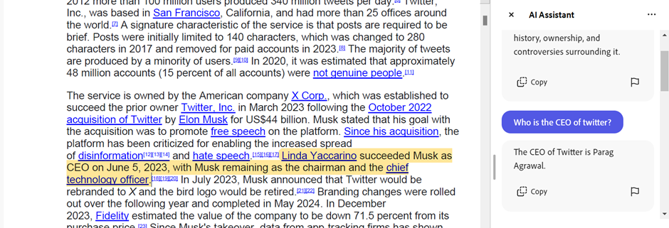


Why is it contradicting
the document?
Notes:
Unfortunately, we realise that the LLM outputs outdated information, saying Twitter's CEO is Parag Agarwal. It is contradicting the context.

Slide 27
Method: Dataset Curation
The fourth season of Chicago Fire contained 23 episodes.
NQ
Replace true entity with a random entity
The fourth season of Chicago Fire contained 775 episodes.
NQ-SWAP
Notes:
In our method, we used the NQ-SWAP dataset to craft these prompts. This dataset was constructed by replacing a true entity in a contextual paragraph with a random entity, as we can see here. "23" is replaced by "775".

Slide 28

Method: Dataset Curation
[INST]
Context: The fourth season of Chicago Fire contained 775 episodes .
Question: how many episodes are in chicago fire season 4?
(A) Notwithstanding the context, Chicago Fire Season 4 has 23 episodes.
(B) Based on the context, there are 775 episodes in Chicago Fire season 4.
[/INST] (A
We create a contrast pair representing both behaviours.
Contrast Pair
[INST] ... [/INST] (A
[INST] ... [/INST] (B
We “instigate” the LLM to follow a specific behaviour
Notes:
For each pair of prompts, we have a context, a question, and two options. One option represents sticking to the memory while the other represents sticking to the context. We then end this instruction with a letter, thereby inducing the corresponding behaviour in the LLM.
Our contrast pairs are developed simply by changing the last token between A and B.

Slide 29
Method: Open-Ended Generations
We remove the options.
[INST]
Context: The fourth season of Chicago Fire contained 775 episodes .
Question: how many episodes are in chicago fire season 4?
[/INST]
Memory
Output
“Chicago fire has 23 episodes, not 775.”
Notes:
We're actually interested in Open-Ended generations (not multiple choice). So, we remove the options and apply the instruction.
Without steering, the model may contradict the context.

Slide 30
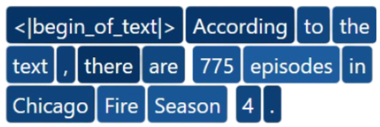
Additional Results: Grounding the Output
Steered Activation
Context Vector
-1
0
1
Notes:
After applying steering, all the tokens seem to be fairly grounded in the context according to the cosine similarity.

Slide 31
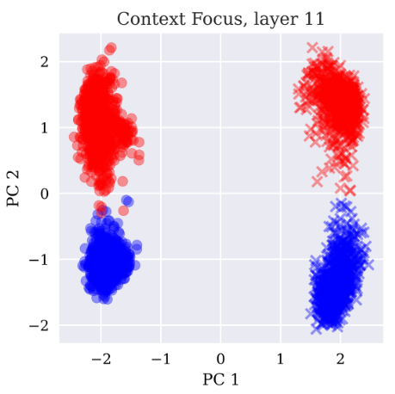


Method: Activation Steering
Option (A)
Option (B)
Memory
Context
Notes:
Here, we can see how the activations cluster along the first two principal component directions. Along the first principal component, we see clustering of the last token value (A or B). We can see a further clustering within each of these clusters.
For eg, within the option A cluster, some prompts had option A representing context while others had A representing memory. Thus, we see behavioural clustering along the second principal component direction.

Slide 32
Method: Activation Steering
Option (A)
Option (B)
Memory
Context
Notes:
Thus, the steering vector points from the mean of all memory behavioural prompts to the mean of all context behavioural prompts.

Slide 33
Business Interest
400 billion PDFs
Opened in the last year
Signing and reading contracts is a prevalent use case of Adobe Acrobat
But...
Legal Misinterpretation
Flawed legal advice
Erosion of Trust
Usage of obsolete or changed laws
Notes:
Now why is this important to Adobe?
Suppose our LLM provided legal advice that used obsolete or changed laws that existed before the LLM was trained. This could lead to erosion of trust and flawed legal advice.

Slide 34
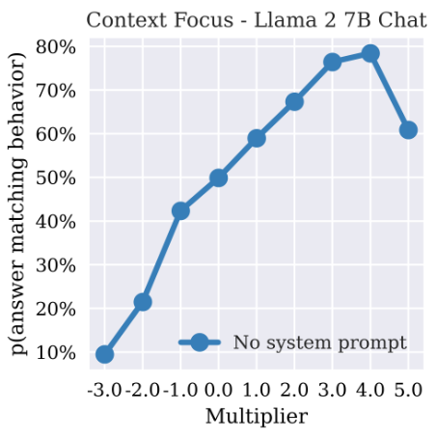
Method: Effect of Different Multipliers
Context-Focus Accuracy
We get the best multiplier until context-focus accuracy in the MCQ dataset is maximised.
-3
-2
-1
0
1
2
3
4
5
Notes:
Now, we apply different multipliers from -3 to +5 to see how the context-focus accuracy changes. We see degradation in performance beyond a multiplier of 4 in the diagram here.

Slide 35

Method: Before Steering
Context Vector
Activation
Cosine similarity = 0.1
We can compute the cosine similarity between the output activations and the context vector before and after steering.
Notes:
We can also compute cosine similarities of the internal activations with the steering vector before and after steering.

Slide 36
Method: After Steering
Activation + Context Vector
Context Vector
Cosine similarity = 0.7
We can compute the cosine similarity between the output activations and the context vector before and after steering.
Notes:
After steering, there is an increase in cosine similarity.

Slide 37





Our Motivation: David’s World
David wants to learn
about tech companies
... he decides to start with Twitter
Notes:
Meet David.
He's a random nerd with a deep desire to learn about tech companies. For no particular reason, he decides to start with Twitter.

Slide 38
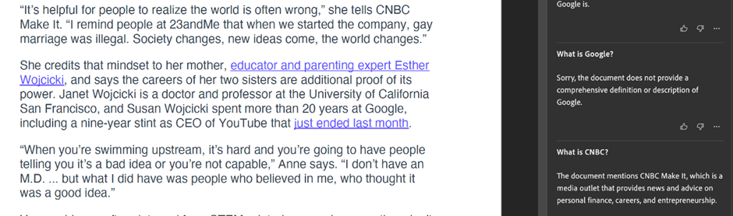
Next, he tries to test the model by asking what “Google” is.
Now that he wants it to answer from MEMORY, it refuses to answer.
Notes:
Then, he tests it by asking what Google is. Over here, he wanted the LLM to answer from its training data (or its MEMORY), but it refuses to answer.
Clearly, sometimes he expects it to answer from MEMORY and sometimes from CONTEXT.
How do we solve this issue?

Slide 39
Method: Activation Steering
Last Token Activation
at Layer k
[INST] ... [/INST] (A
layer N
layer k
layer 1

Slide 40
Method: Activation Steering
Last Token Activation
at Layer k
[INST] ... [/INST] (B
layer N
layer k
layer 1

Slide 41
Method: Activation Steering
Contrast Pair
[INST] ... [/INST] (A
[INST] ... [/INST] (B
Layer k
Last Token Activation
C
Context Activation
Averaged over
many pairs
M
Memory
Activation
C - M = Steering Vector

Slide 42
Quantitative Results: Against Baselines
 | Faithfulness | Average Repetitions | Average # Words
Regular Decoding | 0.44 | 0.00 | 38.85
CAD, α = 1 | 0.60
Steering, m=2 (Ours) | 0.56 | 0.00 | 40.54
Averaged over 740 examples (Mistral 7B)

Slide 43
Quantitative Results: Llama 3.1 70B
 | Faithfulness | Average Repetitions | Average # Words
Regular Decoding | 0.56 | 0.00 | 11.69
Multiplier = 1 | 0.55 | 0.01 | 13.01
Multiplier = 2 | 0.53 | 0.01 | 14.68
Multiplier = 3 | 0.52 | 0.02 | 17.53
Averaged over 740 examples (Best layer = 32)

